Slide 1

Rockbuster Stealth Data Analysis
Prepared by: Shaival Mehta

Slide 2
Table of Contents
1 | Introduction and Objective of Rockbuster on this Project
2 | Analysis of 5 Key Questions
3 | Recommendations based on Analysis of the Key Questions
4 | References

Slide 3
Tools Used
SQL
Tableau
MS Excel
MS PowerPoint

Slide 4

Introduction
Rockbuster Stealth LLC, a renowned movie rental company, is navigating challenges posed by fierce competition from streaming giants like Netflix and Amazon Prime. To remain competitive and leverage its extensive library of movie licenses, Rockbuster Stealth is strategizing to launch a cutting-edge online video rental platform. This move aims to adapt to shifting consumer preferences and position the company as a key player in the digital entertainment landscape.

Slide 5
Objectives
The Rockbuster Stealth Management Board has outlined a series of critical business questions, seeking data-driven insights to shape their 2020 company strategy effectively.

Slide 6
5 Key Questions
Which movies generated the highest and lowest revenue?
What is the average rental duration across all videos?
In which countries are Rockbuster’s customers located?
Where are the high lifetime value customers primarily based?
How do sales figures differ across geographic regions?

Slide 7
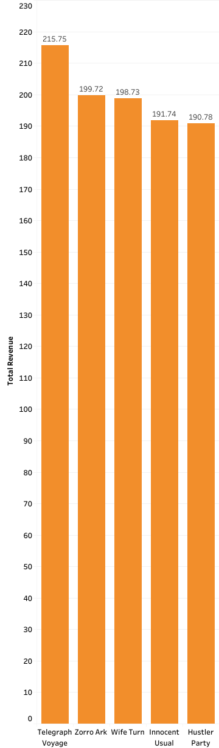
Which movies generated the highest revenue?
Top 5 Revenue-Generating Movies:
Telegraph Voyage
Zorro Ark
Wife Turn
Innocent Usual
Hustler Party
Revenue Range: $190.78 – $215.75

Slide 8
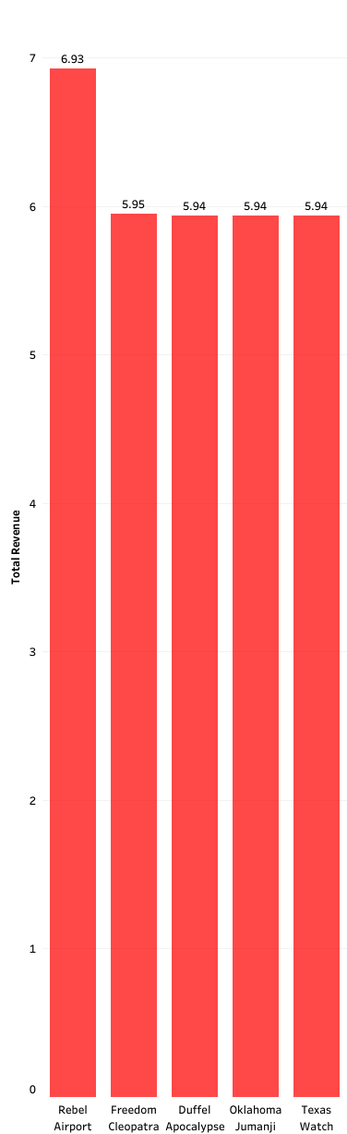
Which movies generated the lowest revenue?
Top 5 Lowest Revenue-Generating Movies:
Rebel Airport
Freedom Cleopatra
Duffel Apocalypse
Oklahoma Jumanji
Texas Watch
Revenue Range: $5.94 – $6.93

Slide 9
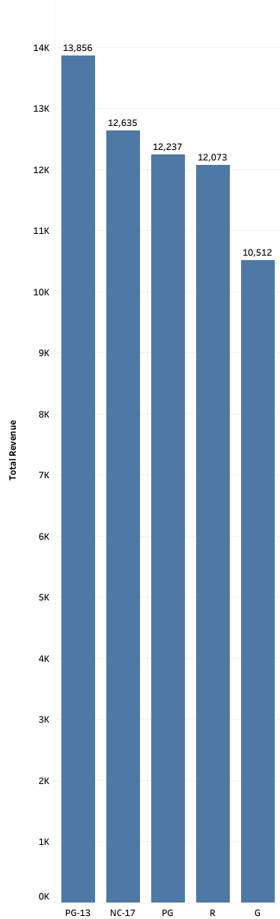
Revenue Insight
Movies with a PG-13 rating generated the highest total revenue, outperforming the second-highest category NC-17 by 9.66%.

Slide 10
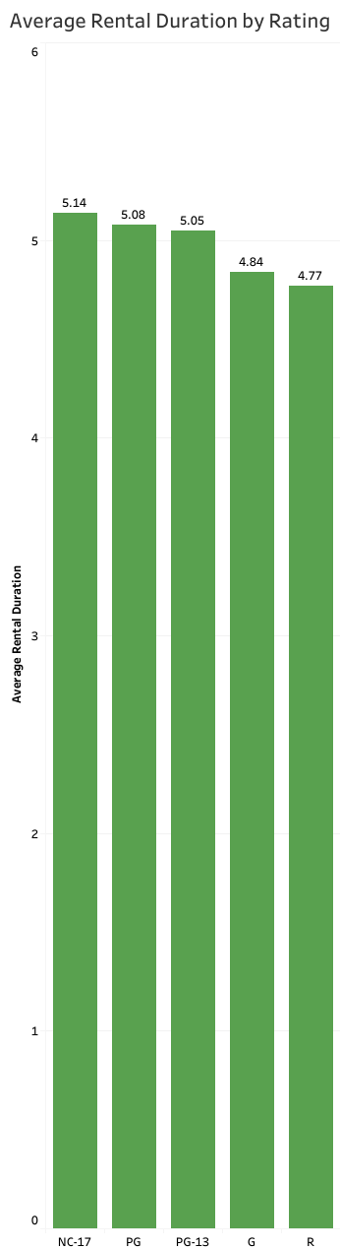
What is the average rental duration across all videos?
Average Rental Duration for All Videos: 4.98 days
Average Rental Duration by Rating:
NC-17 movies have the longest average rental duration.
All ratings show similar averages, ranging from 4.77 to 5.24 days.

Slide 11
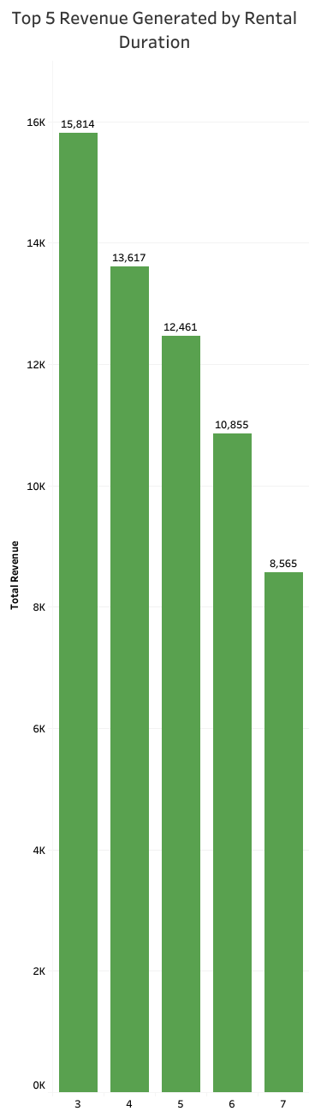
Rental Duration Insight
The shorter the rental duration, the higher the total revenue generated.

Slide 12
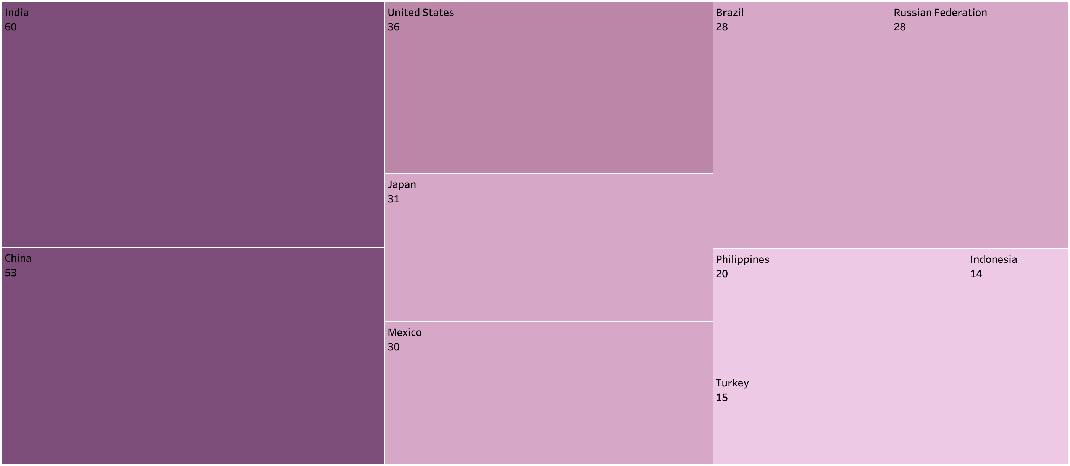
In which countries are Rockbuster’s customers located?
Countries India, China, the USA, Japan, and Mexico, each with a customer range of 30–60.

Slide 13
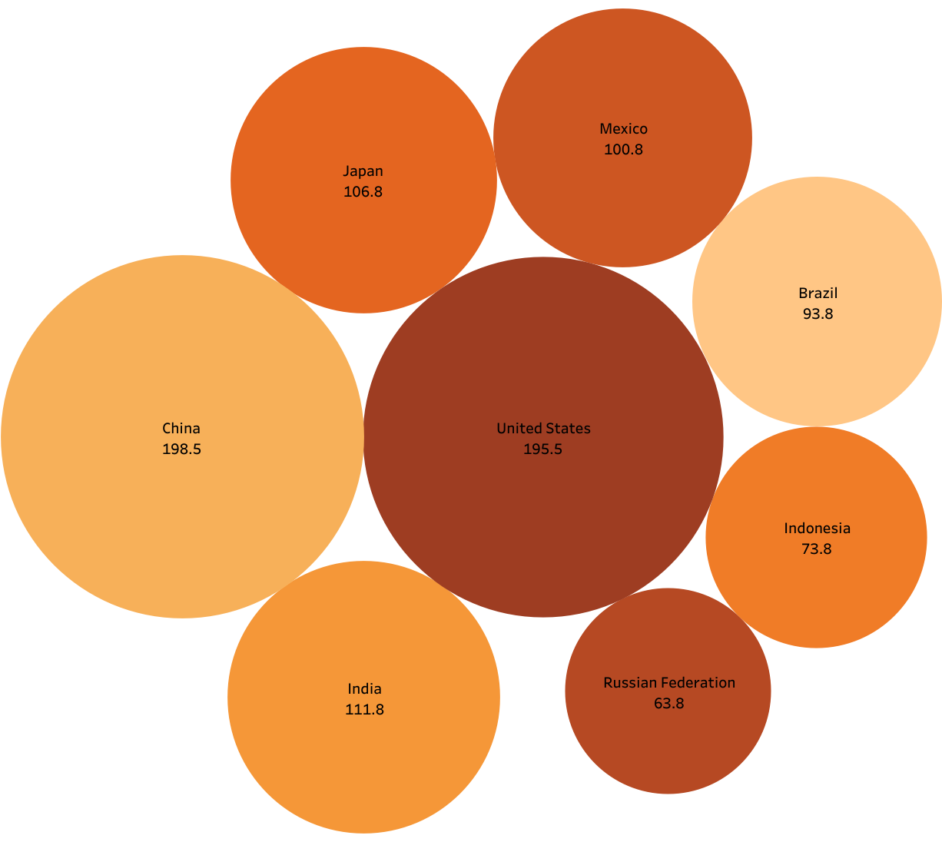
Where are the high lifetime value customers primarily based?
The top 10 countries with the highest-value customers. Among these countries, China ranks first in total revenue.

Slide 14
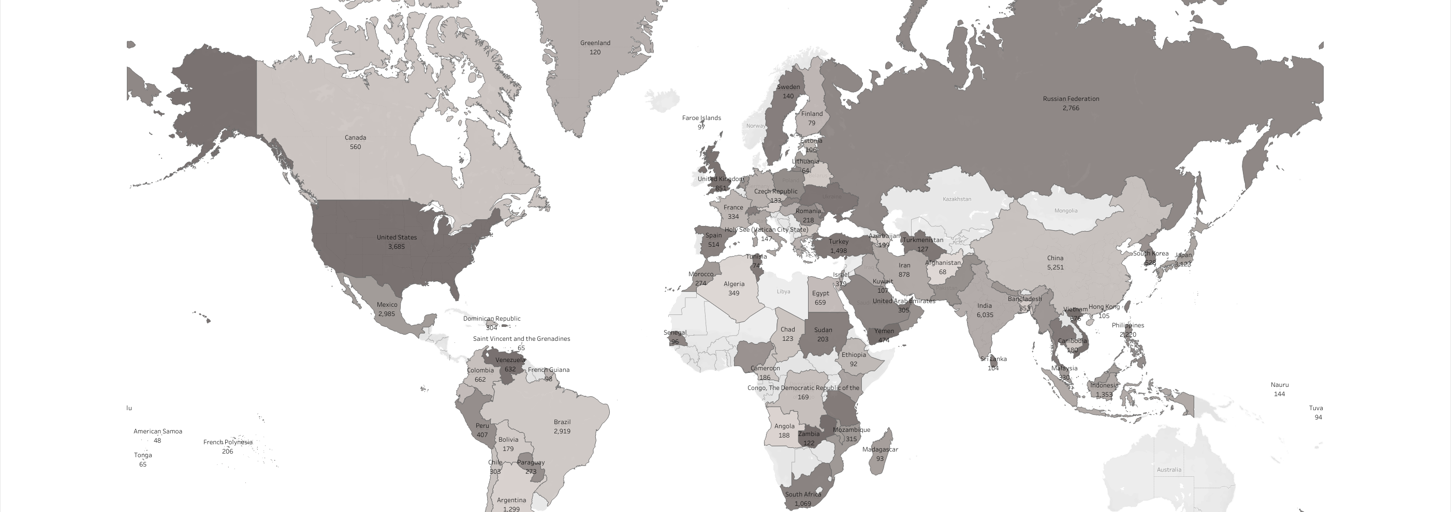
How do sales figures differ across geographic regions?
India has the highest sales.

Slide 15
Recommendations
Geographic Market Expansion
Asia accounts for over 40% of total revenue. Consider investing in customer engagement initiatives in this region, such as a loyalty program.
Develop targeted strategies to increase revenue in Oceania and South Africa.
Targeted Marketing by Rating
PG-13 and NC-17 rated movies generate the highest revenues. Rockbuster should prioritize marketing efforts for movies with these ratings.
Investigate the root cause of the low revenue from G-rated movies, despite being suitable for all ages. In the meantime, implement promotional campaigns to boost sales for this rating.
Inventory Optimization
Increase inventory for high-revenue, high-demand movies to maximize profitability.
Analyze the bottom 5 least-revenue movies to determine if they should remain in stock. Consider reallocating resources to higher-demand movies instead of retaining low-demand titles.
Long Rental Duration Optimization
Data indicates that shorter rental durations generate higher revenue. Explore strategies to boost revenue from long-duration rentals while maintaining customer satisfaction. Potential solutions include adjusting pricing structures or increasing inventory for long-duration titles to enhance availability and appeal.

Slide 16
References
Acheivement3: 1.1 Top 5 the most revenue movies | Tableau Public
Acheivement3: 1.2 Top 5 the least revenue movies | Tableau Public
Acheivement3: 1.3 Top revenue by rating | Tableau Public
Acheivement3: 2.1 Average rental duration by rating | Tableau Public
Acheivement3: 2.2 Total revenue by rental duration | Tableau Public
Acheivement3: 3. Top countries where Rockbuster customers are based in | Tableau Public
Acheivement3: 4. Top 10 countries where the highest lifetime value customers based in | Tableau Public
Acheivement3: 5. Top 10 countries with the highest total sales figures | Tableau Public

Slide 17

THANK YOU

